Slide 1

Colechain
Innovating & Analyzing blockchain

Slide 2



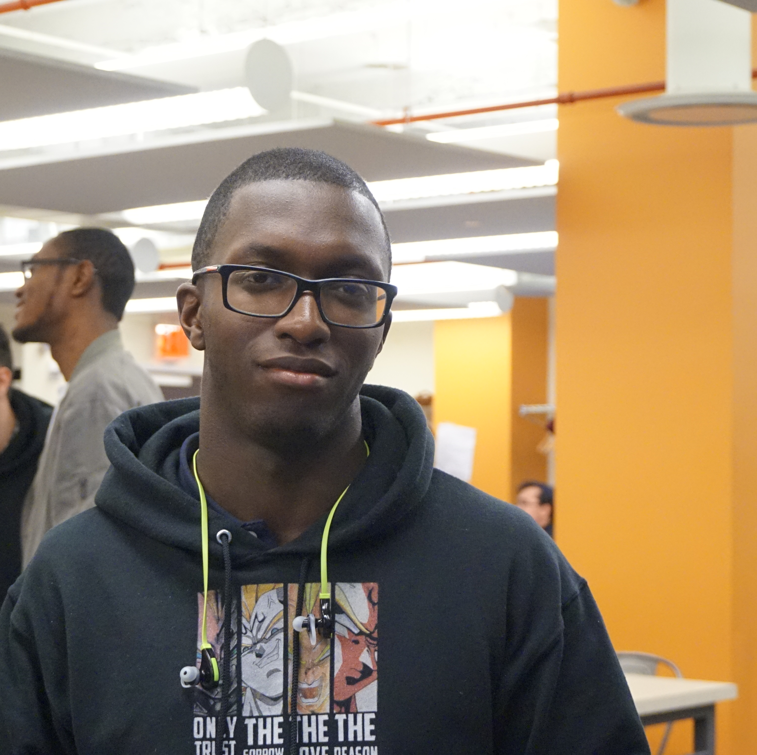

Team
Taehun Lim Project developer
Sumaita hussain Backend developer
Leslie jargueta
Frontend developer
Daniel Gaston
Backend developer
President & founder of crypto club @CCNY
Facilitator of cybersecurity course
Leading backend developer of Invention Corps

Slide 3

Problem
Existence of intrinsic factor that determines salary

Slide 4
Today’s solutions
Using 3rd party website(glassdoor)
2. Asking co-worker of how much they’re getting paid

Slide 5
Why it doesn’t work
Inaccuracy
Not transparent
Inefficient
Truth/Trust

Slide 6
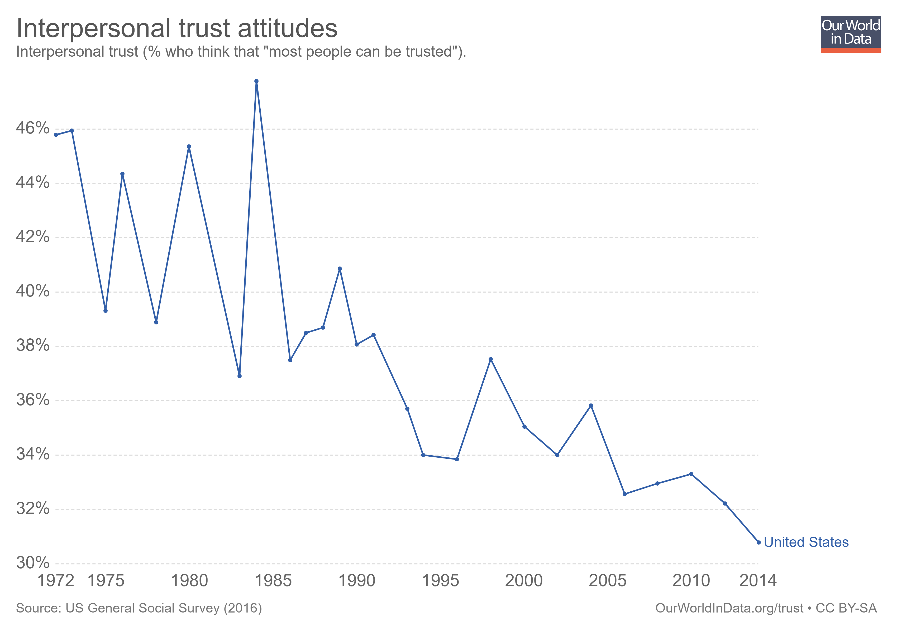

Slide 7
Our solution
Create Blockchain platform that has data of companies salary only according to extrinsic factor

Slide 8
Our solution
Company wants to know equitable salary for their newly hired worker
Upload company's salary data on blockchain ledger
Receive access to blockchain ledger
Adjust the salary according to its data it received from blockchain ledger
Create equitable salary

Slide 9
Product
Blockchain platform with decentrailized ledgers
Algorithm for data analysis of those ledger

Slide 10

Why not centralized ledger with one party owning all the data?

Slide 11
Awesome features of using blockchain
Security
No point of failure
Data is cryptographically signed
Accuracy
Efficiency

Slide 12
How It Works
Create Ledger
Customer’s Info
Extract data
Determine average salaries
Generate expected pay
Salary, Skillset, Average Proficiency, Company
Notes:
Aggregate data from companies through surveys – company, salary, hard skills (i.e. c#, react.js, nosql), and weighted proficiency
Extract data from ledger
Use data to find average salary of job titles, taking skillset + proficiency into account
Now clients can, using their qualifications, look up how much they can expect their salary to be in a certain company

Slide 13
Product Demo

Slide 14
Truth/Trust

Slide 15

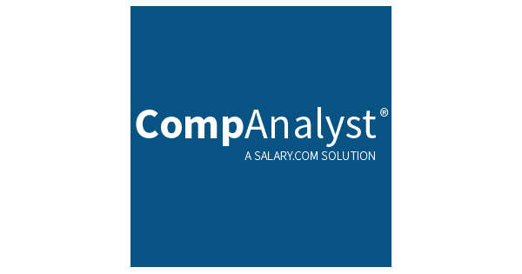

Competitors

Slide 16
High Security
MSI
ColeChain
Glassdoor
Companalyst
High Accuracy
Low Accuracy
Linkedin Salary
High Efficienty

Slide 17
 | YOUR COMPANY | GlassDoor | MSI | Salary.com
Best security
Accurate Data
Low-cost
Ease of accesing data

Slide 18
Business Model
Initial
Free Service
Middle
Trial period
Final
Charge yearly subscription based on number of employee
Blockchain Analytics
80% of revenue
Advertisement
20% of revenue
B2C
B2B

Slide 19
Market Sizing
$40.8b
$10b
$.55b
Big Data
Compensation Survey
Blockchain
Source : statisca
Source : salary.com
Source : statisca

Slide 20
Market size Size over Time: Big data
Market Sizing (in $billions)

Slide 21
Marketing- B2B
Company can access the ledger if they update their data
Can save about 20k a year on getting data from compensation survey
Contributing to open source
Blockchain
Implement of new technology
Equality
Good PR

Slide 22
Thanks for listening

Slide 23
Roadmap
02/2016
04/2016
06/2016
Market Overview
Pre-Release
Launch
01/2016
03/2016
05/2016
Introduction
Partnerships
Beta

Slide 24
Say you want to make the world a better place

Slide 25
Icons

Slide 26
Icons

Slide 27
Social

Slide 28
Red
Pink
Purple
Deep Purple
Indigo
Blue
Light Blue
Cyan
Teal
Green
Light Green
Lime
Yellow
Amber
Orange
Deep Orange
50
50
50
50
50
50
50
50
50
50
50
50
50
50
50
50
100
100
100
100
100
100
100
100
100
100
100
100
100
100
100
100
200
200
200
200
200
200
200
200
200
200
200
200
200
200
200
200
300
300
300
300
300
300
300
300
300
300
300
300
300
300
300
300
400
400
400
400
400
400
400
400
400
400
400
400
400
400
400
400
500
500
500
500
500
500
500
500
500
500
500
500
500
500
500
500
600
600
600
600
600
600
600
600
600
600
600
600
600
600
600
600
700
700
700
700
700
700
700
700
700
700
700
700
700
700
700
700
800
800
800
800
800
800
800
800
800
800
800
800
800
800
800
800
900
900
900
900
900
900
900
900
900
900
900
900
900
900
900
900
A100
A100
A100
A100
A100
A100
A100
A100
A100
A100
A100
A100
A100
A100
A100
A100
A200
A200
A200
A200
A200
A200
A200
A200
A200
A200
A200
A200
A200
A200
A200
A200
A400
A400
A400
A400
A400
A400
A400
A400
A400
A400
A400
A400
A400
A400
A400
A400
A700
A700
A700
A700
A700
A700
A700
A700
A700
A700
A700
A700
A700
A700
A700
A700

Slide 29
Gradient 1

Slide 30
Gradient 2

Slide 31
Gradient 3

Slide 32
Gradient 5

Slide 33
Forecast

Slide 34
Financial Table
 | 2016 | 2017 | 2018 | 2019 | 2020
Sales | 0 | 50 | 400 | 1000 | 3000
Revenue | - | $100 000 | $800 000 | $2 000 000 | $6 000 000
Gross Margin (%) | - | 49% | 51% | 53% | 58%
Expenses | - | $128 000 | $450 000 | $800 000 | $1 200 000
Net Profit | - | $-28,000 | $350 000 | $1 200 000 | $4 800 000
Profit Margin (%) | - | -28% | 44% | 60% | 80%

